Slide 1
Forms and Tables Exercise
Chapter 8 and 9

Slide 2
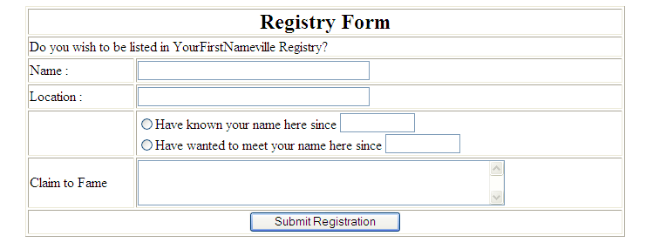
Forms and Tables Exercise
Using what you learn in forms and tables try to imitate the one below.
Change the word YourFirstNameville to like for example EdperVille.

